Slide 1
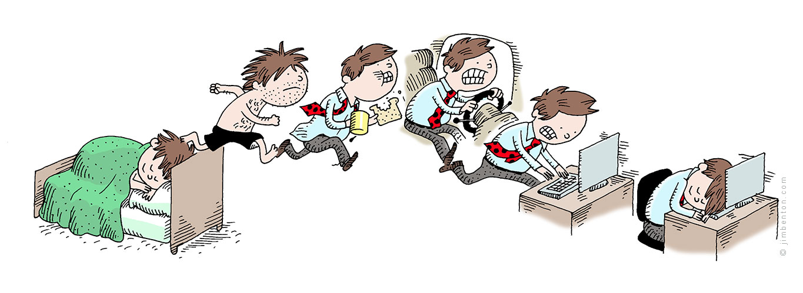
Good Afternoon All

Slide 2
Operating Systems in practice – Linux
SOUNDARARAJAN DHAKSHINAMOORTHY
soundararajan@outlook.com

Slide 3
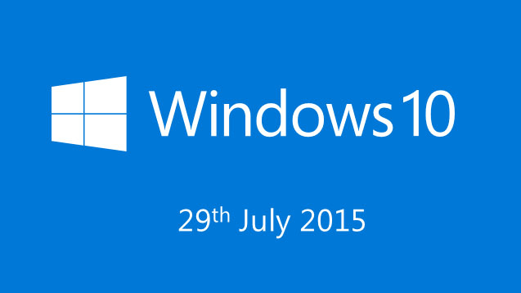

Today !

Slide 4
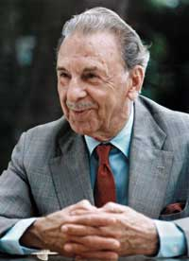
Today in History J.R.D Tata (birth anniversary)
More than ever before, we must be ready to think every problem afresh, to change and innovate…

Slide 5
Agenda
Introduction
Booting
Kernel
Hardware abstraction
Process
Virtual Memory
Q & A

Slide 6
Booting
When you power on the system, who initializes all the hardware ?
What steps should be taken to initialize the hardware ?
You remove the keyboard from your PC and who finds that ?
How does the system date and time work, when I switch off the PC ?
Where does operating system comes into picture ?
how does the computer find and boot into an operating system ?

Slide 7
Booting
On power on a “special program” will be loaded from a special ROM in motherboard. Remember it’s not in the hard disk.
This program knows the details of RAM, Processor, USB ports, SMPS, Keyboard etc., and will run a test on all of them to see if booting can be continued.
It will initiate then start the process of loading the operating system.

Slide 8
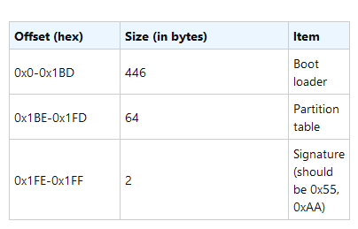
Booting….
Now the program finds the primary hard disk and runs the code in first 512 bytes of the harddisk a.k.a MBR (Master Boot Record)
The MBR looks through all the partitions in the hard disk and finds the boot partition (a partition marked as boot) show `parted` command
It then executes the first 512 bytes in the corresponding partition a.k.a boot sector. The 0th byte of that partition should be a valid instruction. This will load the operating system kernel ☺

Slide 9
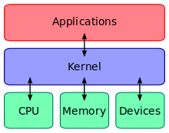
Kernel
The kernel is a computer program that
manages I/O (input/output) requests from software,
translates them into data processing instructions for the central processing unit and other electronic components of a computer.
Communicates with hardware.
The kernel is usually loaded into the protected area of memory, which prevents it from being overwritten. [Discuss how this is supported in hardware]

Slide 10
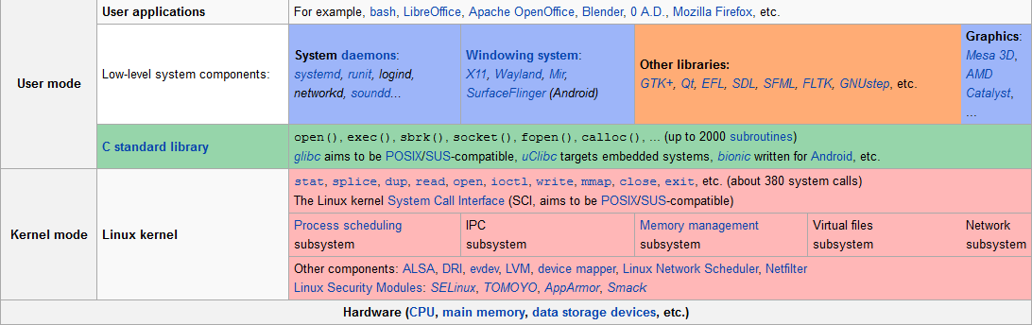
A practical view (linux kernel)

Slide 11
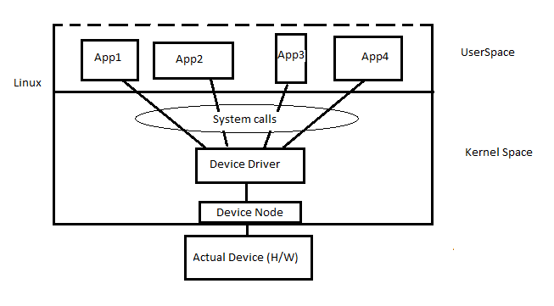
Hardware abstraction
Under Linux and UNIX each and every hardware device treated as a file. (show /dev)
A device file allows to accesses hardware devices
Character files (1 byte at a time) (cat /proc/devices, ls –l)
Block files (512 bytes to 32 KB)

Slide 12
Hardware abstraction
cat /proc/iomem
Why do all the address starts with ‘f’ ?
All devices are IO memory mapped, meaning you can write to or read from any peripheral device using an address.
The operating system loads the correct device driver and makes sure the data is properly interpreted and fed to the applications and vice versa.
lsmod all devices
Show dmesg on system initialization sequence.

Slide 13
A simple device driver
/home/minion/kinetic/driver
The code (Hello.c)
Building the driver (Build.sh)
Registering a kernel mode driver module (Insmod hello.ko )
View whether it’s loaded into kernel (dmesg (or) cat /var /log/syslog)
Interrupt handler , show that a key is pressed
Let them understand what a driver is capable of.
Where is the driver running ? (ps –A)

Slide 14
Processes
A process is a special file (Agree ?)
What is a difference between a text file and a exe file
Write a small executable and run it.
Objdump –s the executable.
Objdump –s the text file.
Binary vs content, valid instructions vs ascii data.

Slide 15
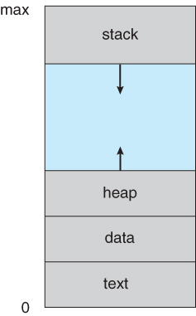
A detailed look into the process
Objdump –h
The text section comprises the compiled program code,
The data section stores global and static variables, allocated and initialized prior to executing main.
The heap is used for dynamic memory allocation, and is managed via calls to new, delete, malloc, free, etc.
The stack is used for local variables. Note that the stack and the heap start at opposite ends of the process's free space and grow towards each other.
When processes are swapped out of memory and later restored, additional information must also be stored and restored. Key among them are the program counter and the value of all program registers.

Slide 16
A detailed look into process
Ps –A (when the process is running), show that process when process finished. Foobar.c
Top (show the processor usage of a process when it’s running in full speed, full) fullcpu.c
Top (show the processor usage when we insert sleep cycles, and change in delay, cpudelay.c)
Htop and multiple instances of a process and how it works cpudelay.c multiple instances.
Htop and multiple instances of a process > number of cores (cpudelay.c)

Slide 17

Memory management
Why does memory management always speaks about virtual memory.
What is the connection between physical memory and virtual memory
Why is it called virtual ?
Let’s inspect a program to understand this (basic.c)
The address of a variable is the same all the time ??? Holy Cow
Address of local variables and global variables ?? Nuts!!
(lessbasic.c) print address of local, global variables and main function

Slide 18
Explore the memory more
Verylessbasic.c
Compile the program and run objdump
See the bss section, data section
Break on a program, and explore the stack from /proc/<pid>/stack
Add memory pressure and see what happens with htop (pressure.c)
Seg fault with a big allocation
Also see the stress command
Physical address
Use ps to find process id and explore /proc/<pid>/maps
They are not the same every time.

Slide 19
Virtual memory stats in general
/proc/vmstat
Nr_page_table_tables
Nr_pagein
Nr_pageout
Pswpin
Pswpout
pgfault

Slide 20

That’s all about it

Slide 21
Q & A

